Slide 1
The Watershed Connection
Prepared by Emma Melvin, PHS
Rod Ritchie, AKRF
Notes:
Welcome to this Green Infrastructure Maintenance Training. This presentation is one of several in the training series.
You can view the entire series sequentially, or each module independently.

Slide 2
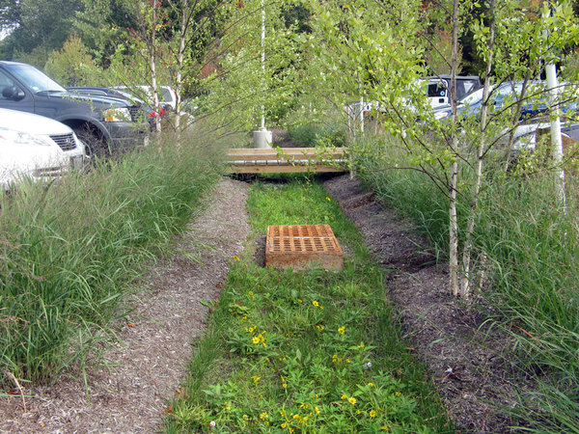
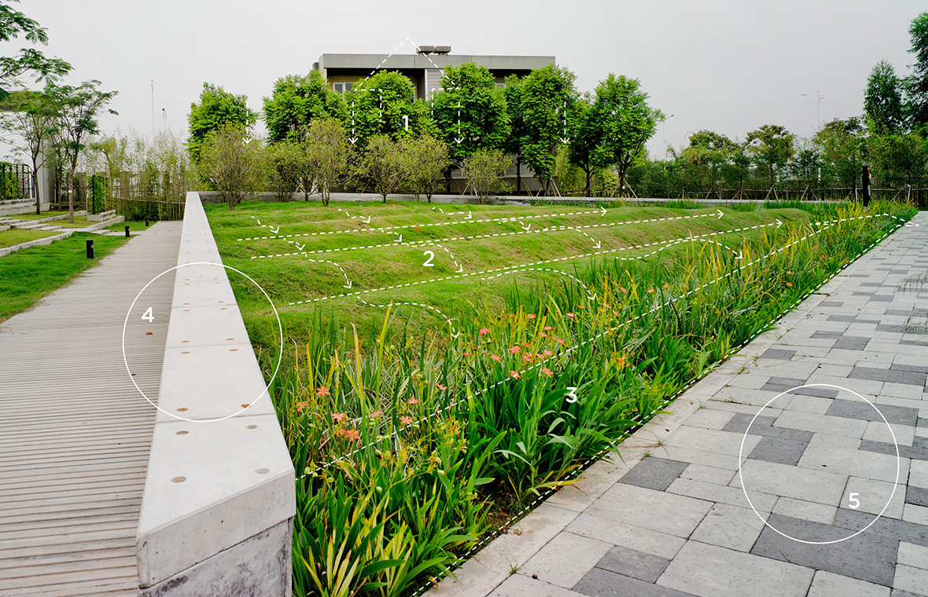
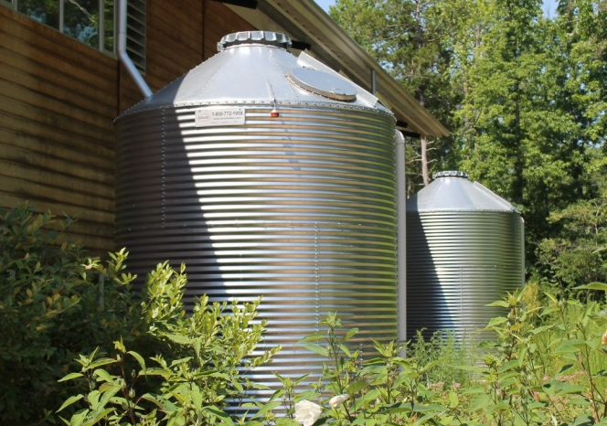
Overview
What is a watershed
What is stormwater runoff and why is it important to manage it
What are Combined Sewer Outfalls (CSO) and Municipal Separate Storm Sewage Systems (MS4s)
What are Stormwater Best Management Practices, or SMPs
Notes:
This presentation focuses on the way that stormwater affects our environment and why we need to manage it.
You will learn:
What is a watershed
What is stormwater runoff
Why it’s important to manage stormwater and stormwater runoff
What are Combined Sewer Outfalls (CSO) and Municipal Separate Storm Sewage Systems (MS4s)
What are Stormwater Best Management Practices, or SMPs

Slide 3
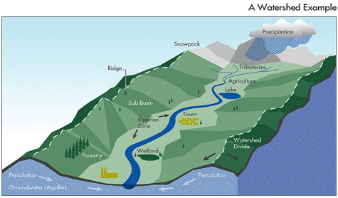
What is a Watershed?
Notes:
What is a watershed?
Let’s start by defining a watershed: It is the area of land that drains into a particular body of water. A watershed can be small, like the land that drains into a puddle. Or it can be large, like the land that drains into major rivers and the Atlantic Ocean. Everyone lives in a watershed, even if you don’t see the stream or river into which your watershed is draining. The watershed contains everything that covers the land, including forests, buildings, roads, lawns, and drainage piping networks that include storm drains and culverts that are used to carry rain water to the nearest waterbody.

Slide 4
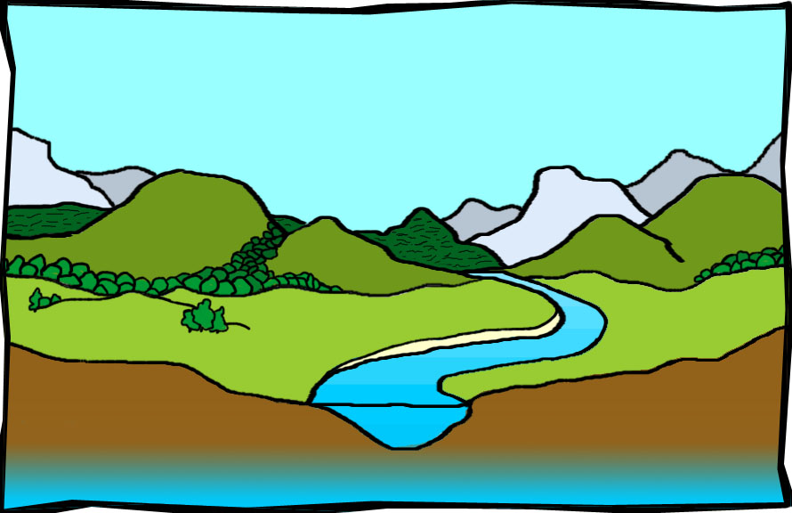
What is Stormwater?
Slide courtesy of Perkiomen Watershed Conservancy
Notes:
What is stormwater?
Stormwater is rainwater that eventually makes its way to a river by overland flow, through drainage systems, or by groundwater collecting in an aquifer and slowly moving underground to the river.
In natural landscapes such as forests, the soil absorbs much of the stormwater, and plants help hold stormwater close to where it falls.
In developed environments, there are impervious surfaces that prevent rain from infiltrating, or soaking into the ground. When rainwater hits impervious surfaces, it then becomes unmanaged Stormwater Runoff that travels across the surface of the land. Unmanaged stormwater can create two major issues:
The first issue is flooding, caused by the volume of rainwater and how quickly the stormwater runoff accumulates.
The second issue is nonpoint source pollution, which are contaminants that the stormwater runoff carries to the river.
These issues are why it’s important to manage stormwater runoff from developed areas.

Slide 5

Land Cover and Stormwater
Notes:
To understand why it is important to manage stormwater, we need to understand how land cover affects the way water moves over the land, and the way this water affects streams, lakes and other water bodies.
How do forests manage rain water? In forested land areas, rain is intercepted at multiple levels. First, in the canopy of leaves much of this water is evaporated back into the air. As the rain water travels down the tree trunks, some becomes absorbed by the bark, then travels down the trunk to be absorbed in the roots and leaf litter on the forest floor. The remainder soaks into the ground. Very little water runs over the surface of the forest floor into water bodies. Most enters water bodies through subsurface flow or ground water.

Slide 6


Land Cover and Stormwater
Notes:
How has watershed land cover changed? Human beings change the natural land cover by clearing the trees, putting up buildings, creating roads, diverting water and stream flow (sometimes leading underground into pipes) and replacing native plants with cultivated plants like lawns and turf grass. Each of these changes alters the flow of water through the watershed into the receiving water body.
How have those changes impacted the path of rain to rivers? Through every step of development, we change the way stormwater flows to the river. As we remove trees, we reduce the amount of water that is captured in the leaves and evaporated back into the air. So more water reaches the ground and flows over the surface of the land. Without the leaves to reduce the energy of rain drops and without roots, the soil is no longer protected. This causes soil erosion as the water hits the unprotected ground and moves quickly across the surface.
When we construct buildings and roads, we reduce the amount of pervious surface that would allow rain water to infiltrate and replenish ground water supplies. Surface water runoff picks up pollutants from our built environment – lawn chemicals, fluids from cars, pet waste, litter and other materials that can adversely affect our aquatic environment. This is called nonpoint source pollution.
In an undisturbed area, the stream slowly rises and falls during a rain event. But in a built environment, the water level rises quickly to extremely high levels and falls quickly. Aquatic insects and animals can not adjust to the rapid rise and fall of the water level, and their homes are destroyed during these events. Over time these streams lose most of the insects and animals that support the aquatic food chain.

Slide 7

Land Cover and Stormwater
Notes:
In the past, we tried to drain the water from developed areas as quickly as possible. Now, we realize that it’s important to try to replenish the groundwater supply whenever possible. We use stormwater best management practices or SMPs in developed areas to mimic the natural environment. SMPs do this by collecting, detaining, and filtering stormwater before it travels downstream to sewer collection systems. Examples of some SMPs include rain gardens, detention basins, porous pavement, and cisterns or large tanks used to capture and hold stormwater for a later use.

Slide 8
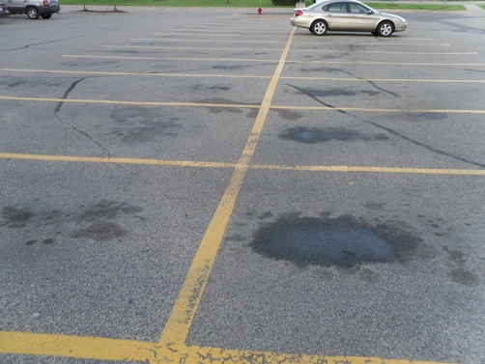
Understanding Stormwater Issues
Notes:
Stormwater rushing across impervious surfaces picks up anything it encounters along the way and washes it into streams and rivers through the urban collection systems. This is called nonpoint source pollution.
Cars drop oil, antifreeze and other toxic materials onto streets and parking lot pavements…

Slide 9
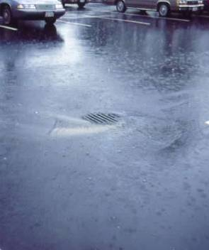
Understanding Stormwater Issues
Notes:
…The rushing stormwater lifts the oils and other harmful chemicals from the surface of the parking lot and carries them down drains such as the stormwater inlet pictured here.

Slide 10
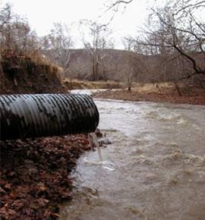
Understanding Stormwater Issues
Notes:
Stormwater travels through underground pipes and exits the system through an outfall into an open body of water.
The toxic pollutants and eroded soil can kill aquatic animals, large and small, living in the streams. Aquatic animals are important to protect as they are a critical part of the food chain.

Slide 11

Understanding Stormwater Issues
Notes:
Stormwater pollution doesn’t just occur in urban areas. In suburban areas, residents prefer their lawns to look green and lush, but to get them that way many people overdo fertilizers and pesticides. Any chemicals that don’t get absorbed into the grass will lay on the surface and be swept into streams by stormwater runoff. The ways to prevent it are: 1) to reduce the amount of chemicals applied to turf or 2) to filter the stormwater through a stormwater management practice (SMP).

Slide 12
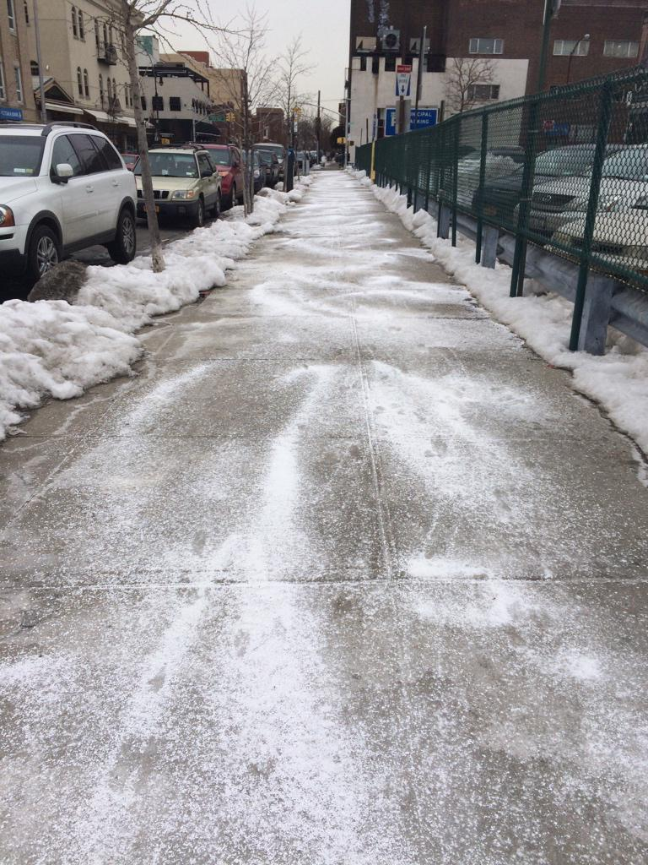
Understanding Stormwater Issues
Notes:
Salt applied to streets and sidewalks also leads to nonpoint source pollution when the snow melts. Salt is toxic to nearby plants. Using other substances such as kitty litter or cracked feed corn can provide the same service without toxic consequences.

Slide 13
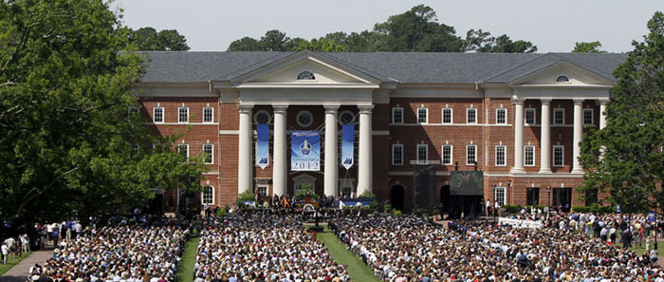
Understanding Stormwater Issues
Notes:
Compaction causes soils to become essentially impervious. Compaction occurs when heavy loads, such as this large crowd or heavy equipment, compress the underlying soils to the point where water cannot soak into the ground and instead becomes stormwater runoff. This crowd will most likely also leave litter on the ground, which gets washed into the storm sewers.

Slide 14

Understanding Stormwater Issues
Notes:
This scene looks lovely, but the grass and flowers that are planted right up to the edge of the stream do not hold the soil well with their roots and have most likely been over-fertilized. This pollutes the water and leads to erosion of streambanks, and ….

Slide 15
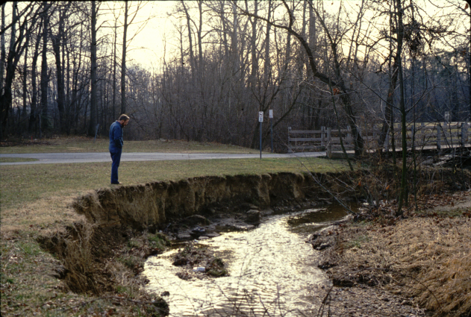
Understanding Stormwater Issues
Notes:
…eventually, streambank collapse. Excessive soil particles in a stream destroy aquatic habitat.

Slide 16
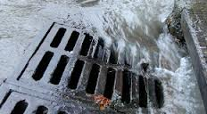
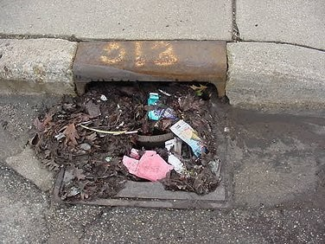
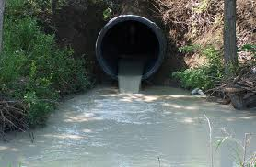
Managing Stormwater
Grey Stormwater Infrastructure
    Stormwater Drains
    Stormwater Outfall
Notes:
What connects development to streams? In developed areas, we have historically attempted to drain water off our built environment as quickly as possible. To do this, we have changed the slope of the land, paved channels and designed all our buildings, roads and sidewalks to move water quickly and efficiently away, into a conveyance or drainage system.
There are usually two kinds of conveyance systems: 1) an open system made up of swales and pervious surfaces; and 2) a closed system (also called grey storm water infrastructure) consisting of storm drains, pipes, culverts and outfalls that are connected directly to a local water body.
How does this affect the management of water in a watershed? These systems remove the water from the streets, but also increase the volume and the speed at which the storm water reaches the stream. Large quantities of fast-moving water have more force to erode the stream beds and banks, with the capacity to pick up and carry more sediment and other surface pollutants.

Slide 17
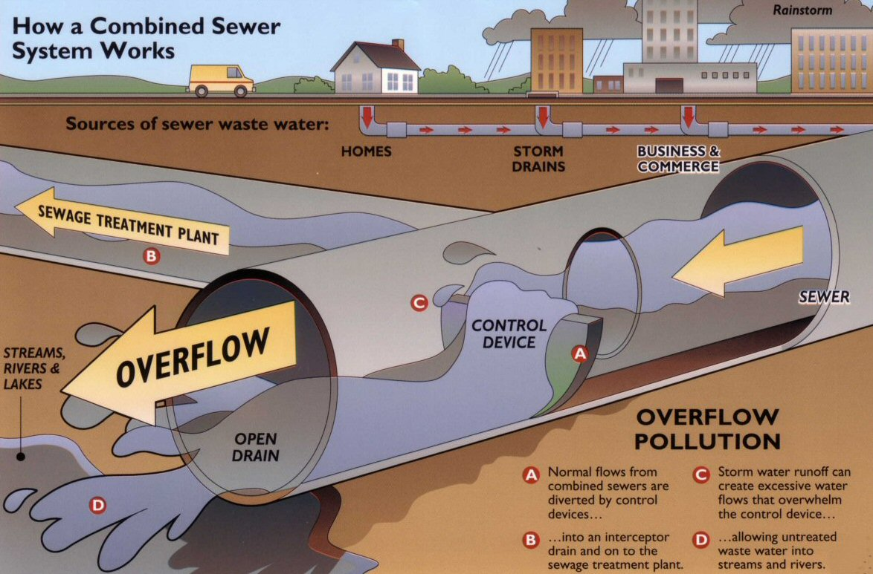
Managing Stormwater
Grey Stormwater Infrastructure:
Combined Sewer System
Notes:
In urban areas there are two types of closed, or grey, stormwater conveyance systems – separate storm sewers and combined sewers.
What is a combined sewer system and what happens when it overflows? In older systems, storm water pipes underground are combined with sanitary sewage pipes coming from buildings. During dry weather, the pipes carry only the sanitary sewage which is diverted to a wastewater treatment plant. During rain events, however, those same pipes will also carry large volumes of storm water. These systems were designed only to carry a certain volume of water, and when that water level is exceeded by the combined sewage and storm water, the additional water overflows directly into water bodies, carrying the sewage with it. We call these events combined sewer overflows or CSOs.
Cities all across the USA have been required by law to reduce or eliminate these overflows because they are obviously detrimental to water quality. Most cities plan to accomplish this in one of two ways:
by either temporarily storing the stormwater and then slowly releasing it into the combined sewer system to prevent an overflow or;
by infiltrating the storm water into the ground to reduce the total amount of storm water entering into the combined sewer system to begin with.
The City of Philadelphia, for example, has chosen to install “Green Stormwater Infrastructure” or GSI to manage stormwater and reduce Combined Sewer Overflows. Green Stormwater Infrastructure includes various combinations of soil, water and plants that intercept the stormwater; infiltrate or soak a portion of it into the ground; evaporate a portion of it into the air; and in some cases release a portion of it slowly back into the sewer system. Philadelphia’s “Green City, Clean Water” vision is to protect and enhance their watersheds by managing stormwater runoff with innovative GSI throughout the City, while at the same time maximizing economic, social, and environmental benefits.

Slide 18
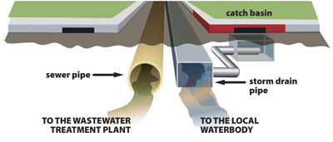
Managing Stormwater
Grey Stormwater Infrastructure:
Municipal Separate Storm Sewer System - MS4
Diagram credit: Anne Arundel Cty, MD
Notes:
The other closed conveyance system is known as an MS4, which stands for Municipal Separate Storm Sewer System. An MS4 is a publicly-owned system of conveyances (such as ditches, curbs, catch basins, and underground pipes) with the storm drainage and sanitary sewage conveyed in separate pipes.
This is a more updated system than a CSO, and since the storm drainage and sanitary sewage are conveyed in separate pipes, it prevents the discharge of sanitary sewage directly into an open body of water. However, without stormwater management practices or SMPs to reduce surface flow, separate storm sewer systems still carry large amounts of polluted stormwater runoff.

Slide 19
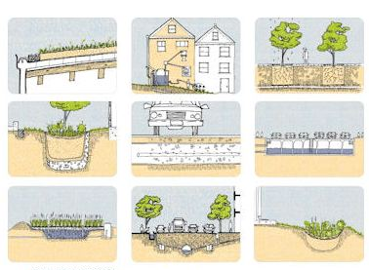
Managing Stormwater
Green Stormwater Infrastructure:
Stormwater management
integrated into the landscape
Notes:
It is more beneficial to mimic the forested environment in urban areas. “Green Stormwater Infrastructure” (or GSI) describes storm water management options that filter and reduce the storm water volume using natural systems, including plants, soils and microbial organisms. Green infrastructure systems are designed to reduce the total volume of water, AND recharge groundwater. They are designed to manage small rain events that make up the vast majority of rain events that occur.
GSI practices can take a number of forms, including the following:

Slide 20
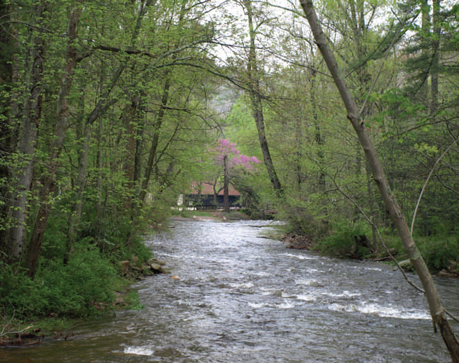
Stormwater Friendly Land Management
Let it flow--directing water to pervious spaces
Riparian Buffer
Notes:
A riparian buffer is a naturally occurring form of Green Stormwater Infrastructure. A healthy stream has a buffer of trees and deep-rooted shrubs adjacent to the water, keeping the stream banks intact and the water pure. Trees and shrubs that buffer a stream help to absorb and slow down rainwater, which helps to reduce flooding and erosion, and filter pollutants.

Slide 21
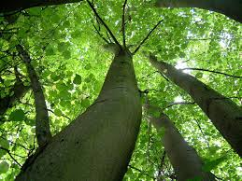
Stormwater Friendly Land Management
Let it flow--directing water to pervious spaces
Community Trees
Notes:
The leafy canopy of every deciduous tree intercepts 67% of the rainfall that hits it. The remaining 1/3 of the rainfall will be slowed down when it hits the ground – some will be taken up by roots, some will infiltrate, and the very little that remains will travel more slowly across the surface of the ground. With less energy, it is less likely to cause erosion and transport harmful fine soil particles along the way. Trees are an important form of Green Infrastructure, whether in a natural setting or planted in an urban landscape.

Slide 22
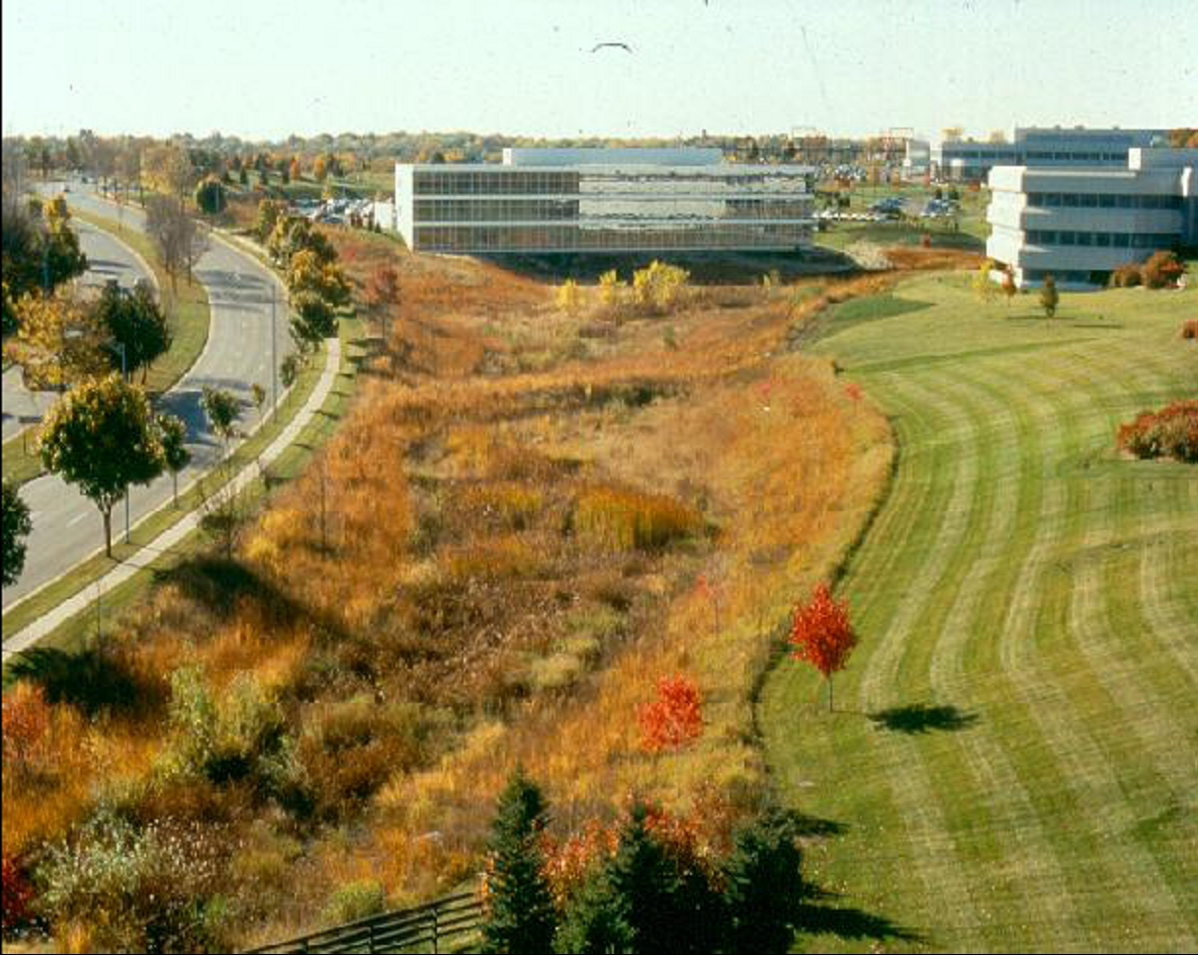
Stormwater Friendly Land Management
Let it flow--directing water to pervious spaces
Bio-retention swale
Notes:
In highly urban and suburban areas, forested cover is limited. So we rely on SMPs and green infrastructure to help mimic the forested environment.
SMPs do this by collecting, detaining, and filtering stormwater before it travels downstream to sewer collection systems.
This bio-retention swale at the bottom of the hill slows down and holds stormwater until it can filter down through the soil. The filtered stormwater soaks into the ground and replenishes groundwater, and what cannot be absorbed will be sent through an overflow outlet to the storm drain system at a slower rate.

Slide 23
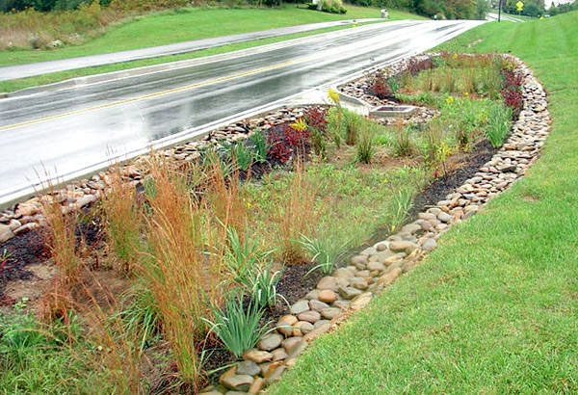
Stormwater Friendly Land Management
Let it flow--directing water to pervious spaces
Curb cut
Notes:
Here, a break in the curb line from the street directs stormwater into a rain garden, where the water can be absorbed by the plants or infiltrate into the ground and replenish the aquifer.

Slide 24
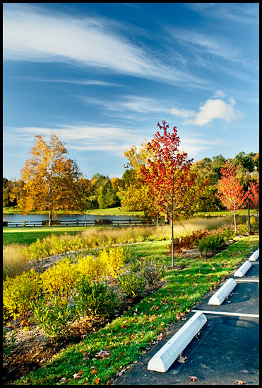
Stormwater Friendly Land Management
Let it flow--directing water to pervious spaces
Notes:
Here, there isn’t a curb, so the water can flow directly from the parking lot down into the adjacent swale, where the plants can absorb some of the stormwater runoff and filter pollutants.

Slide 25
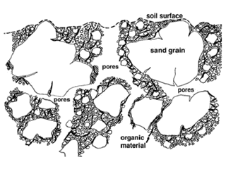
Stormwater Friendly Land Management
Healthy soils = healthy landscapes
Notes:
One key component to effective SMPs and green infrastructure is healthy soil. Healthy soil has 50% open pore spaces between soil particles. The pores hold oxygen and water to support the living organisms in the soil that help filter stormwater. Pore spaces also help to promote infiltration.

Slide 26
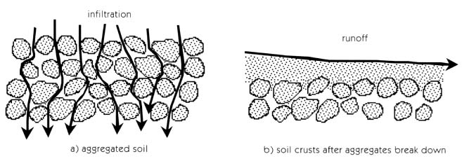
Stormwater Friendly Land Management
Healthy soils = healthy landscapes
Notes:
In healthy soil, the particles gather together to form aggregates or small clumps, which again allows water to percolate through.
Compacting the soil breaks down the aggregates and pushes the soil particles together until they form a crust on the surface. No water can get through the crust, so it acts like pavement, which generates stormwater runoff when it rains.

Slide 27
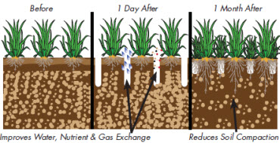
Stormwater Friendly Land Management
Healthy soils = healthy landscapes
Notes:
Healthy soil helps to promote robust and healthy plants that themselves become an important component of SMPs and Green Infrastructure.

Slide 28
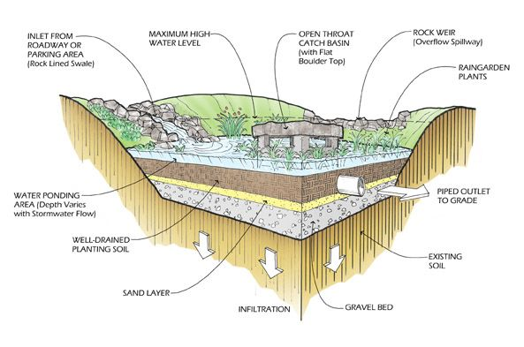
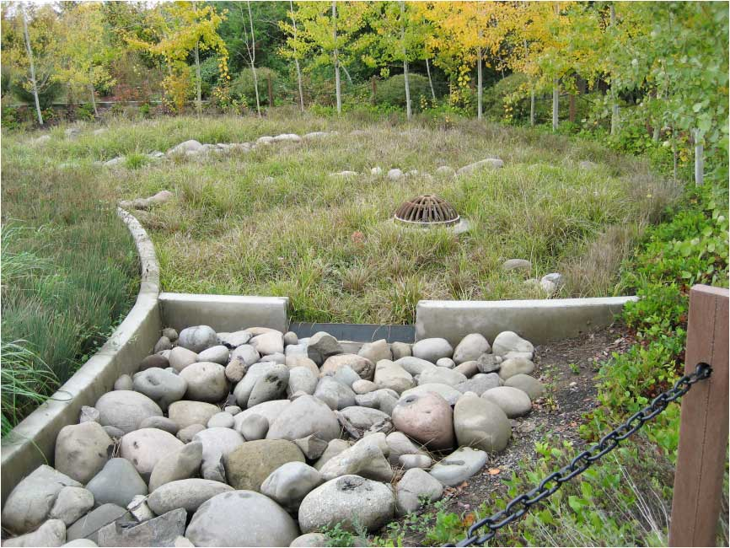
Bioretention Basin/ Rain Garden
Creating space for detaining water
Curb cut
Curb cut
Forebay
Photo: Univ of Idaho
Notes:
This is a graphic of a bioretention basin, which is also known as a rain garden. Plants are installed along the side and throughout the bottom to help filter and absorb stormwater.
Major components of a rain garden include an inlet, a water ponding area and outlets.
The inlet in this case is a rock-lined swale. It is sometimes tiered with several levels. If space is allotted for settling of large particles, it is called a forebay. The forebay can be easily cleaned out for maintenance, usually does not include tall plants and is a smaller, restricted area.
The water ponding area is where water is retained at a depth determined by the height of the overflow structure, held until it can slowly infiltrate into the aquifer. The soil structure under the ponding area is designed to maximize infiltration – sand and gravel under well-drained soil with large pore spaces.
There are two options for excessive water to overflow from the rain garden:
A rock weir, which is a dip in the surrounding wall, lined with gravel, that allows excess stormwater to spill over safely without causing erosion; or
An open throat overflow structure, which is a sewer grate through which the water drops into a concrete box with a pipe that leads to an outfall.

Slide 29
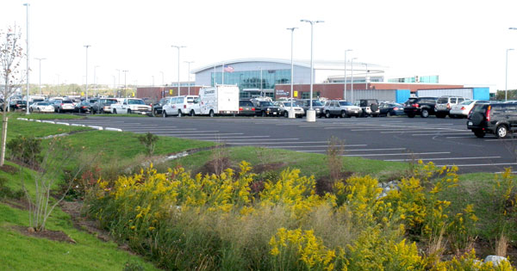
Stormwater Friendly Land Management
Creating space for detaining water
Notes:
Rain gardens are designed so that they function in their specific location, but are also attractive enough to be acceptable to the public. This is a healthy, well-established rain garden draining from a parking lot.

Slide 30
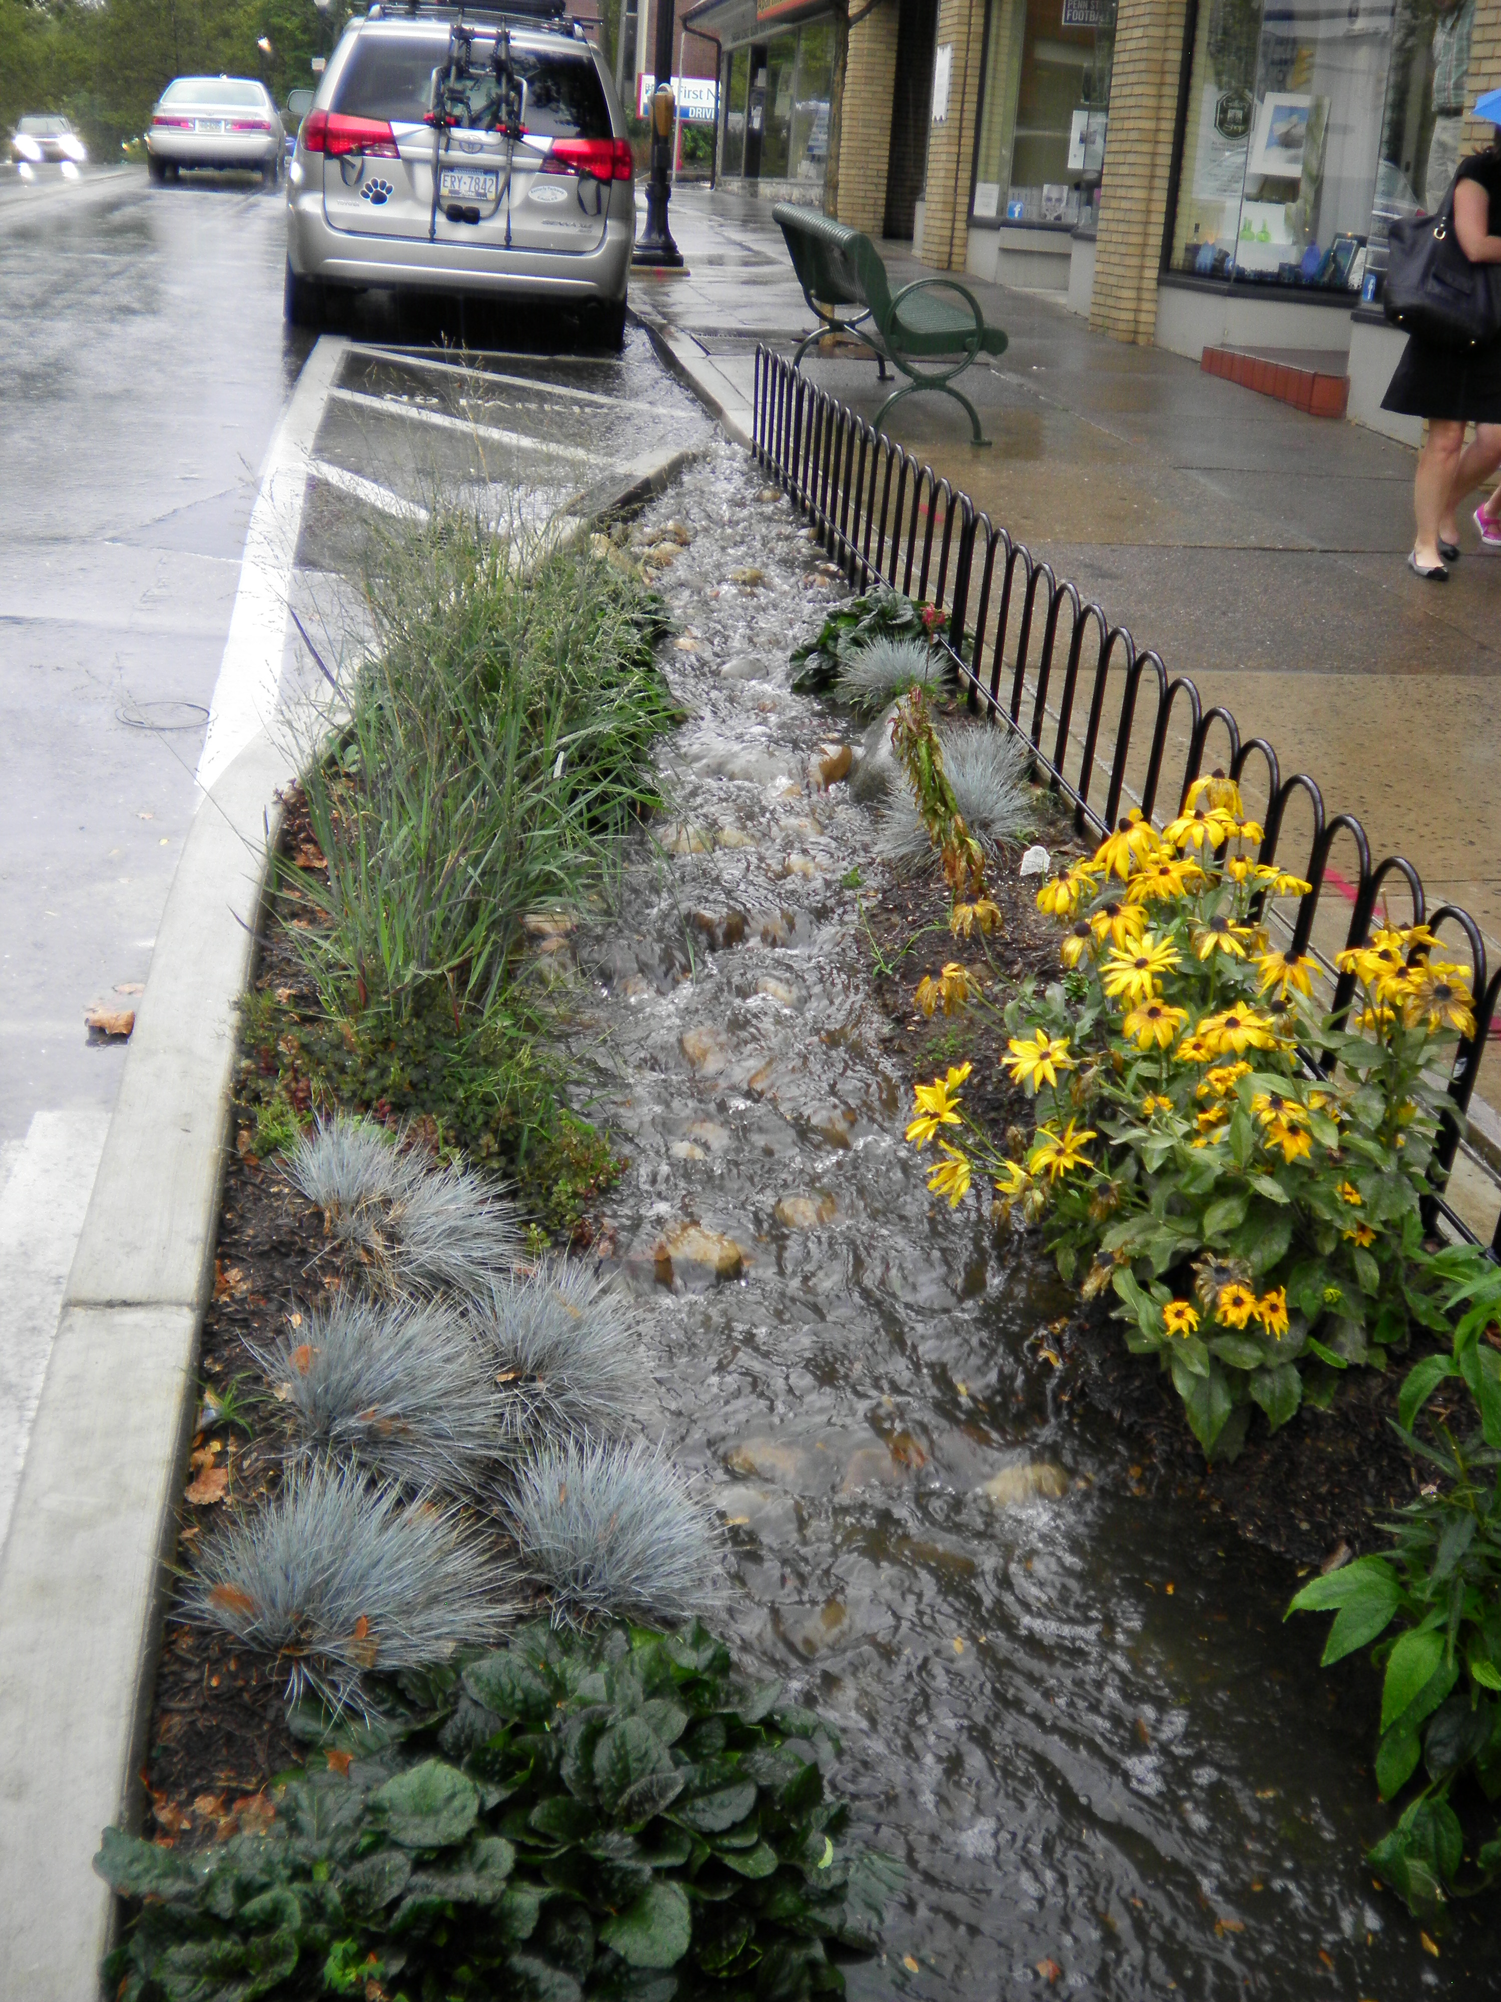
Stormwater Friendly Land Management
Creating space for detaining water
Inlet
Notes:
This is a rain garden in an urban area, with the inlet at the edge of the street.

Slide 31
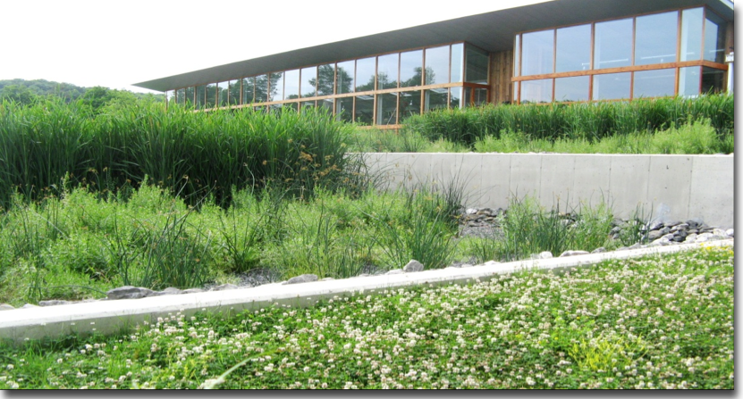
Stormwater Friendly Land Management
Creating space for detaining water
Notes:
And here is a rain garden that is managing stormwater runoff from the roof of an adjacent building.

Slide 32
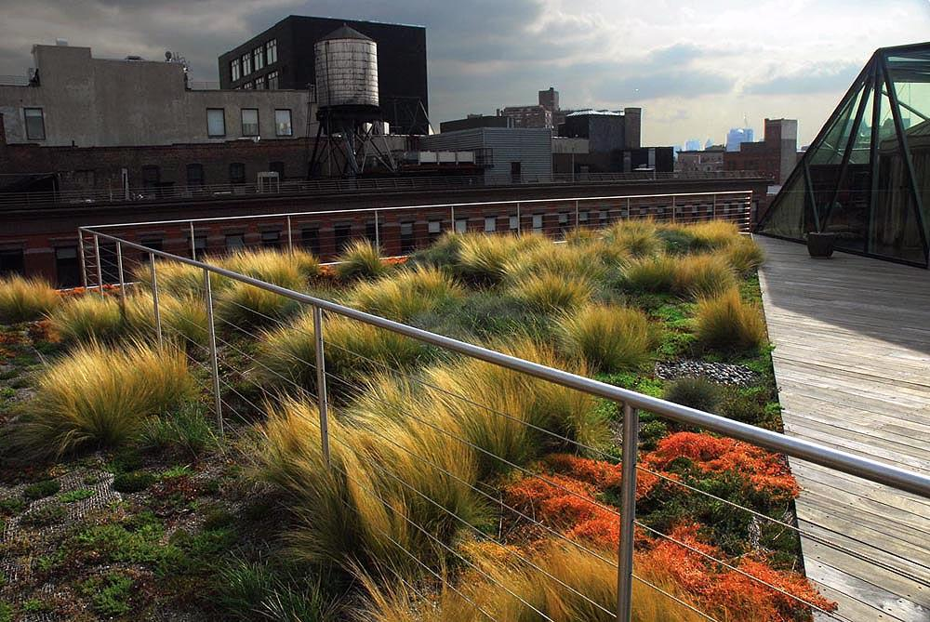
Stormwater Friendly Land Management
Absorbing the storm before it hits the ground
Notes:
Native perennial plants in healthy soil on this green roof absorb a lot of the water hitting the rooftop, preventing it from reaching the street below and entering the storm system. A green roof is an effective type of green infrastructure in a highly urban environment. The greenery could also consist of a series of containerized plants located on the roof.

Slide 33
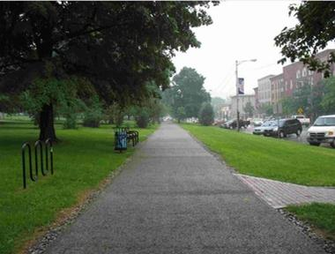
Stormwater Friendly Land Management
Absorbing the storm before it hits the ground
Notes:
Another type of SMP that is considered Green Infrastructure and is effective in an urban environment is pervious asphalt pavement. It has large pores that filter stormwater and allow it to pass through to the ground below. Porous pavement must be maintained to keep the pores free from sediment and debris.

Slide 34
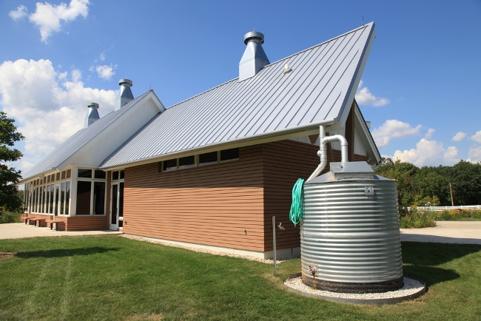
Stormwater Friendly Land Management
Absorbing the storm before it hits the ground
Notes:
A cistern collects rainwater from the roof of this building – holding it until it can be used for flushing toilets in the building or for watering plants during dry periods. This is a larger, commercial version of a home rain barrel, and as is true with rain barrels, it is important to use the water before the next rain storm so there is room in the cistern to capture more rain water.

Slide 35
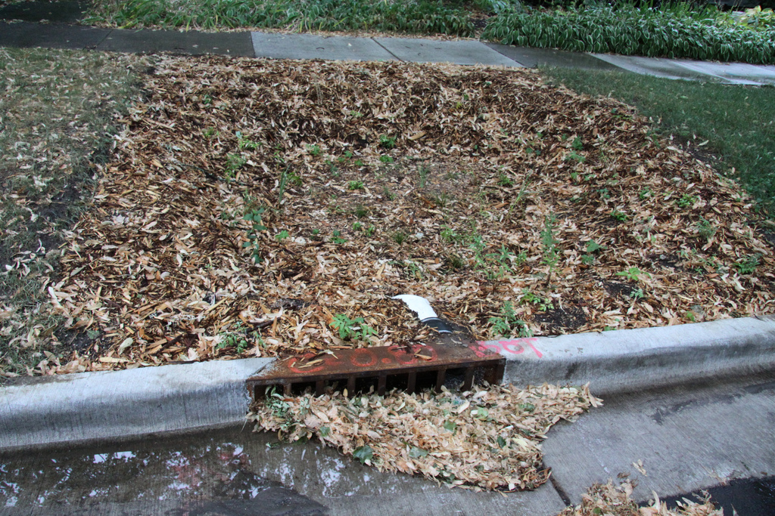
Stormwater Friendly Land Management
Maintaining SMPs
Notes:
It’s important to maintain the components of SMPs so they function properly. This inlet grate is clogged with leaves, preventing stormwater from reaching the SMP and probably causing localized flooding in the adjacent roadway. The debris should be cleared away and measures taken to prevent future clogging if possible.

Slide 36
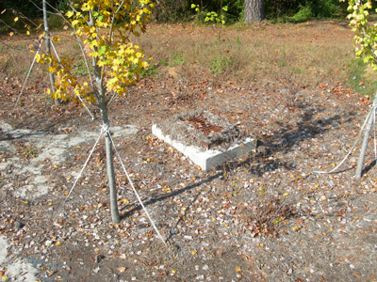
Stormwater Friendly Land Management
Maintenance
Notes:
Here the overflow structure is clogged, preventing proper drainage. Because the water has pooled and drowned out the plants, the rain garden lacks a dense vegetative cover. Regular maintenance to clean the overflow structure will ensure proper drainage.
Another issue could be with the soil. It may be over compacted and need to be scarified or loosened up. It may also need some mulch to add nutrients and organic matter to help promote plant growth.

Slide 37
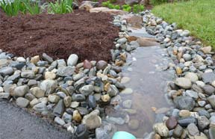
Stormwater Friendly Land Management
Maintenance
Notes:
Here mulch has washed up on a stone outlet apron and needs to be removed so it doesn’t clog downstream components. Although maintenance tasks of stormwater management practices involve mostly common sense, they are critical to keep the systems functioning properly.

Slide 38
You Have Learned:
What is a watershed
What is stormwater runoff and why is it important to manage it
What are Combined Sewer Outfalls (CSO) and Municipal Separate Storm Sewage Systems (MS4s)
What are Stormwater Best Management Practices, or SMPs
Notes:
We hope that you have a better understanding of the way that stormwater affects our environment and why we need to manage it, including the following:
What is a watershed
What is stormwater runoff
Why it’s important to manage stormwater and stormwater runoff
What are Combined Sewer Outfalls (CSO) and Municipal Separate Storm Sewage Systems (MS4s)
What are Stormwater Best Management Practices, or SMPs
Additional sessions in the series will go into more detail on SMPs and how to maintain them.

Slide 39




THANK YOU TO OUR
FUNDER & PARTNERS
Pennsylvania Horticultural Society
100 North 20th Street
Philadelphia, PA 19103
www.phsonline.org
Notes:
This concludes this presentation on the Watershed Connection. Thank you to our funder – the US Environmental Protection Agency Region III, and partners PHS, AKRF, Inc. and GreenTreks Network, which helped produce this series.

